Slide 1
Human-Robot Interaction:
Conducting a User Study
by Talal Shaikh
From the Slides of Dr Katrin Lohan

Slide 2
Overview
What is a study?
Empirically testing a hypothesis
Evaluate interfaces
Why run a study?
Determine ‘truth’
Evaluate if a statement is true

Slide 3
Example Overview
When a naive user is tutoring a robot, he/she will behave towards it like if it were a child.
Many ways to do this:
Look at data from a child parent interaction study
Descriptive design: What’s the pros and cons?
Get a group of people interact with their child and then with the robot.
Analytic design: What’s the pros and cons?
Ideally?
Ideal solution: have everyone in the world interact with the robot and their child
Participants are a sample of the population
You should immediately question this!
Restrict population

Slide 4
Study Components
Design
Hypothesis
Population
Task
Setup
Procedure
Confounds/Biases
Metric

Slide 5
Study Design
How are we going to evaluate the interaction?
Hypothesis
What do you want to find out?
Population
Who?
Task
How do the participants interact with the robot?
Setup
What equipment is involved and how?/ How is the environment structures in your study?
Metrics
How will you measure?

Slide 6
Hypothesis
Statement that you want to evaluate
E.g. It is faster when explaining how to stack-cups if you explain it with language than if you are not allowed to use language.
Create a hypothesis
E.g. Participants using language to explain how to stack-cups to a robot will take less time than participants using only gestures.
Identify Independent and Dependent Variables
Independent Variable – the variable that is being manipulated by the experimenter (interaction method)
Dependent Variable – the variable that is caused by the independent variable. (time)

Slide 7
Hypothesis Testing
Hypothesis:
People who use language and gestures to explain how to stack-cups will be faster, then if they are not allowed to use language.
US Court system: Innocent until proven guilty
NULL Hypothesis: Assume people who use both language and gestures to complete their explanation use the same amount of time then if they only use gestures
Your job to prove differently!
Alternate Hypothesis 1: People who use language and gestures will explaining “How to stack-cups" either faster or slower then when using gestures alone.
Alternate Hypothesis 2: People who use language and gestures will explaining “How to stack-cups” are faster than when using gestures alone.

Slide 8
Population
The people going through your study
Type - Two general approaches
Have lots of people from the general public
Results are generalisable
Logistically difficult
People will always surprise you with their variance
Select a niche population
Results more constrained
Lower variance
Logistically easier
Number
The more, the better
How many is enough?
Logistics
Recruiting (n>20 is pretty good)

Slide 9
Two Group Design
Design Study
Groups of participants are called conditions
How many participants?
Do the groups need the same # of participants?
What’s your design?
What is the independent and dependent variables?

Slide 10
Design
External validity – do your results mean anything?
Results should be similar to other similar studies
Use accepted questionnaires, methods
Power – how much meaning do your results have?
The more people the more you can say that the participants are a sample of the population
Pilot your study
Generalisation – how much do your results apply to the true state of things

Slide 11
Task
Identify the task that your participants will fulfil during a session of your experiment
E.g. explain how to stack-cups
Some times it is not so straight forward!

Slide 12
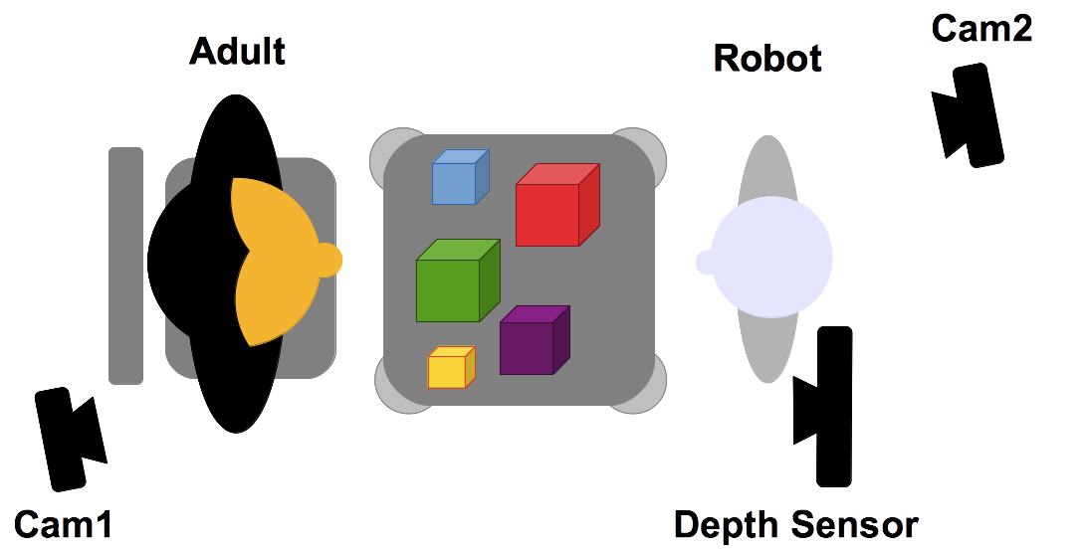
Setup
Describe the equipment you will use in your experiment
technical details
other important features (e.g. size, colour, shape, usability, …)
Describe the space you are using
Use figures or pictures to show the setup:

Slide 13
Design
Participants using language to explain how to stack-cups to a robot will take less time than participants using only gestures.
Let’s create a study design
Hypothesis
Population
Task
Setup
Two types:
Between Subjects
Across Subjects

Slide 14
Hypothesis Testing
Hypothesis: People who use language and gestures to explain how to stack-cups will be faster, then if they are not allowed to use language.

Slide 15
Population
Let’s pick a population for our example?
Group 3-4 people and discuss the best population
Write down how many participants and of what population.

Slide 16
Task
Explain how to stack-cups

Slide 17
Setup
Let’s design a setup for our example?
Group 3-4 people and discuss the best setup
Make a list of the equipment
Draw a setup plan

Slide 18
Procedure
Formally have all participants sign up for a time slot (if individual testing is needed)
Informed Consent
Execute study
Questionnaires/Debriefing

Slide 19
Biases
Hypothesis Guessing
Participants guess what you are trying hypothesis
Experimenter Bias
Subconscious bias of data and evaluation to find what you want to find
Systematic Bias
bias resulting from a flaw integral to the system
E.g. an incorrectly calibrated thermostat
List of biases
http://en.wikipedia.org/wiki/List_of_cognitive_biases

Slide 20
Confounds
Confounding factors – factors that affect outcomes, but are not related to the study
Population confounds
Who you get?
How you get them?
How you reimburse them?
How do you know groups are equivalent?
Design confounds
Unequal treatment of conditions
Learning
Time spent

Slide 21
Metrics
What you are measuring
Types of metrics
Objective
Time to complete task
Errors
Ordinal/Continuous
Subjective
Satisfaction
Pros/Cons of each type?

